Slide 1

‘Brexit’
What does it mean for the GSS?
GSS Conference
08 September 2016
Rob Bumpstead & Will Laffan
UK Statistics Authority

Slide 2
23 June 2016

Slide 3
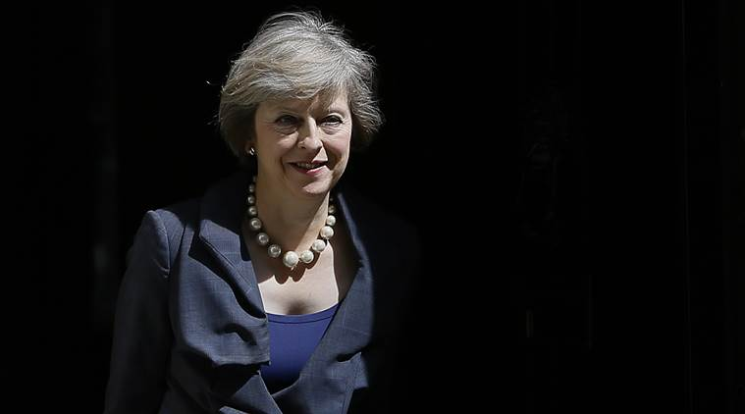
“Brexit
means
Brexit”

Slide 4

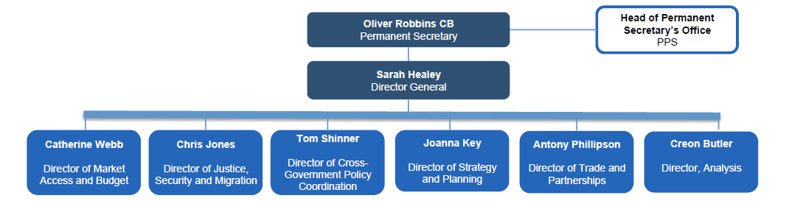

Slide 5

More interest than ever in our statistics .

Slide 6
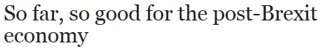
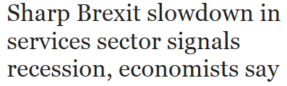
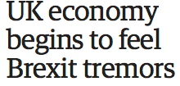
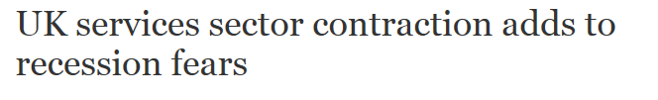
Means more scrutiny than ever of our statistics .

Slide 7

What’s
the impact
on Statistics?

Slide 8


Slide 9

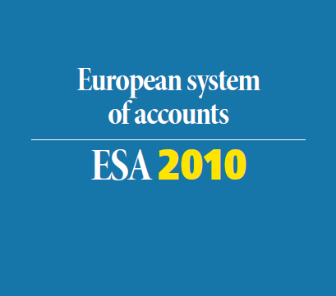

Slide 10
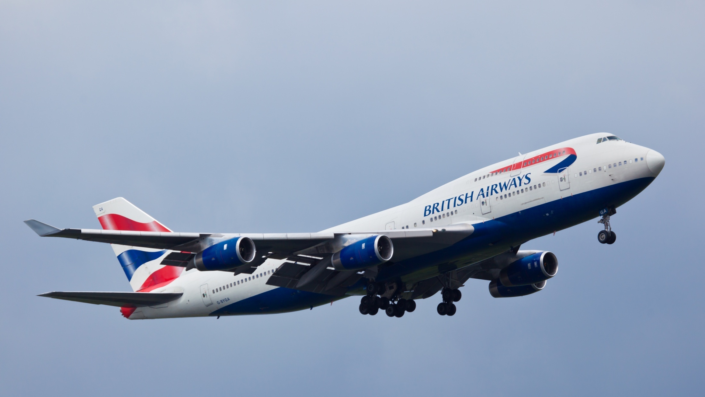
Regulation 437/2003 on statistical returns in respect of the carriage of
passengers, freight and mail by air.

Slide 11

Regulation 1099/2008 on energy statistics

Slide 12

Regulation 543/2009 concerning crop statistics

Slide 13
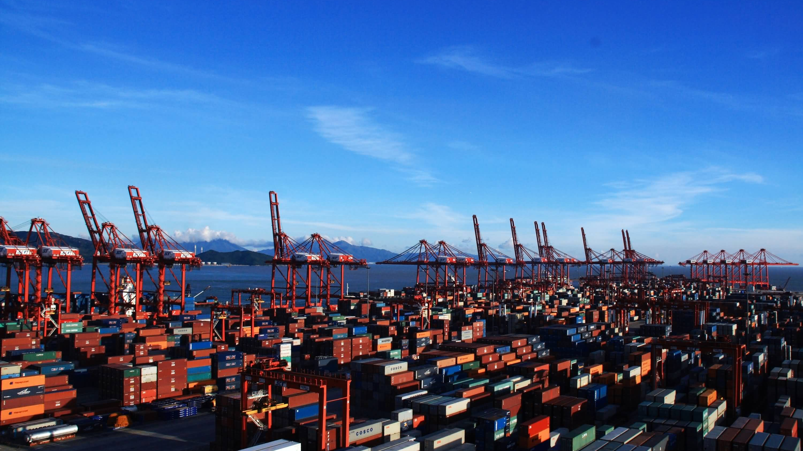

Slide 14


Norwegian lessons? .

Slide 15

Will we be heard
outside the
EU?

Slide 16
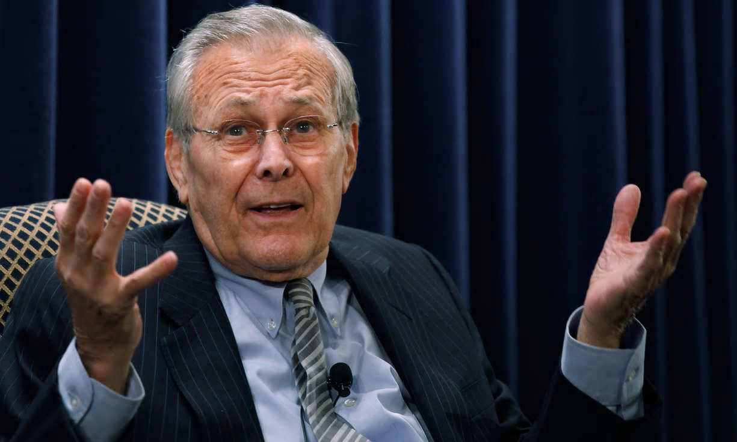
“There are things we
know we don’t know…”

Slide 17
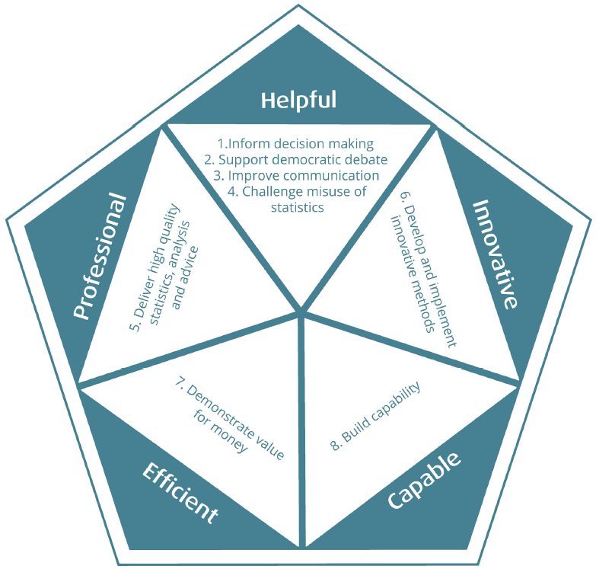
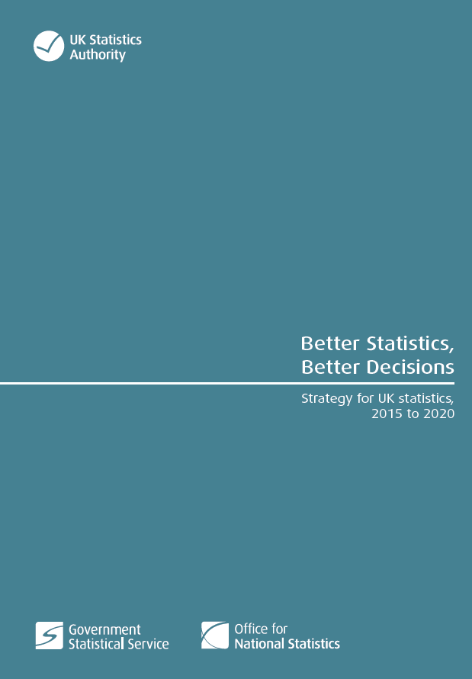

Slide 18
Any questions
?
Contact: will.laffan@statistics.gsi.gov.uk

